Slide 1

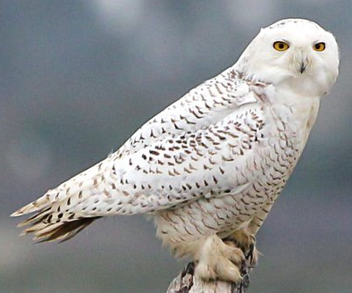
algo-owls
Team Members:
Christian –
Underlying strategy
Jonathan –
Project Plan
Carolina –
Random Forest Metrics
Mark –
LSTM Metrics
January 16th 2021

Slide 2
The Strategy
We aim at anticipating market moves by identifying squeezes that precedes them.
We aim at using 2 EMAs crossovers to anticipate their crossovers for direction predictions.

Slide 3
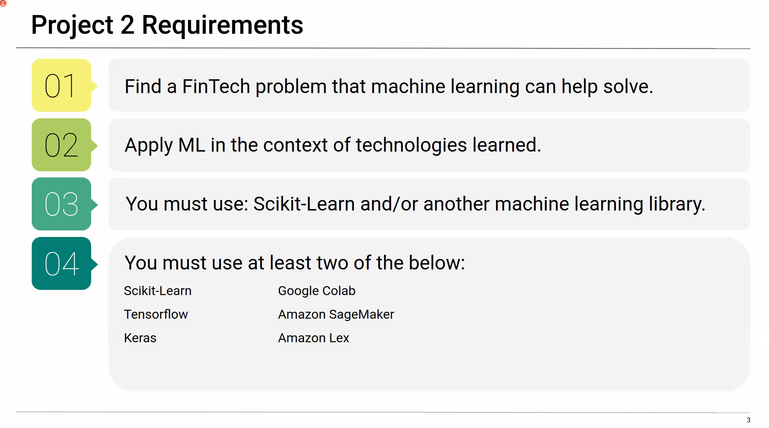
Project Objectives
REQUIREMENTS
OUR SCOPE OF WORK
Build one Machine Learning Model to predict the squeeze breakout and breakout direction.
Use at least two of the libraries specified below:
Build a Machine Learning system comprised of 5 Machine Learning Models:
2 Random Forests Classifiers (squeeze and EMAs crossover)
1 LSTM Binary
2 LSTM price predictors (price entry and target)
Analyze each ML Performance with analytics and metrics.
Libraries and applications:
Scikit-Learn
TensorFlow
Keras
Google Colab

Slide 4
PROJECT PLAN
Mod 2:
Feat_func
python
Mod 1:
Data_imp.

Slide 5
PROJECT PLAN
Mod 3:
Feat_func
Python 2
Mod 2:
Feat_func
python
Mod 1:
Data_imp.

Slide 6
PROJECT PLAN
Mod 4:
Feat_func
& y_gene
TS
Mod 3:
Feat_func
Python 2
Mod 2:
Feat_func
python
Mod 1:
Data_imp.

Slide 7
csv input
PROJECT PLAN
Mod 4:
Feat_func
& y_gene
TS
Module 5:
RF for squeeze
Module 6:
RF for Ema’s
Mod 3:
Feat_func
Python 2
Mod 2:
Feat_func
python
Mod 1:
Data_imp.

Slide 8
csv input
PROJECT PLAN
Mod 4:
Feat_func
& y_gene
TS
Module 5:
RF for squeeze
Module 6:
RF for Ema’s
Mod 3:
Feat_func
Python 2
Selective Function
Module 7
LSTM binary
Mod 2:
Feat_func
python
Mod 1:
Data_imp.

Slide 9
csv input
PROJECT PLAN
Mod 4:
Feat_func
& y_gene
TS
Module 5:
RF for squeeze
Module 6:
RF for Ema’s
Mod 3:
Feat_func
Python 2
Selective Function
Module 7
LSTM binary
Mod 2:
Feat_func
python
Module 8
LSTM price entry
Mod 1:
Data_imp.
Module 9
LSTM price target

Slide 10
csv input
PROJECT PLAN
Mod 4:
Feat_func
& y_gene
TS
Module 5:
RF for squeeze
Module 6:
RF for Ema’s
Mod 3:
Feat_func
Python 2
Selective Function
Module 7
LSTM binary
Mod 2:
Feat_func
python
Module 8
LSTM price e.
Module 10:
Automation
And ML integration
Mod 1:
Data_imp.
Module 9
LSTM price t.

Slide 11
csv input
PROJECT FINAL
Mod 4:
Feat_func
& y_gene
TS
Module 5:
RF for squeeze
Module 6:
RF for Ema’s
RF’s trained & tested
Mod 3:
Feat_func
Python 2
Module 10:
* Automation / ML integration (future developments)
* Develop a .py script using Select Function
* Develop Function that feeds prices from module 8 & 9.
* Discard LSTM binary
Selective Function
Mod 2:
Feat_func
python
Module 8
LSTM price entry
Mod 1:
Data_imp.
Module 9
LSTM price target

Slide 12
csv input
PROJECT FINAL
Mod 4:
Feat_func
& y_gene
TS
Module 5:
RF for squeeze
Module 6:
RF for Ema’s
RF’s trained & tested
Mod 3:
Feat_func
Python 2
Module 10:
* Automation / ML integration (future developments)
* Develop a .py script using Select Function
* Develop Function that feeds prices from module 8 & 9.
* Discard LSTM binary
Selective Function
Mod 2:
Feat_func
python
Module 8
LSTM price entry
EP/TP function
Mod 1:
Data_imp.
Module 9
LSTM price target

Slide 13
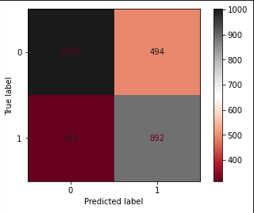
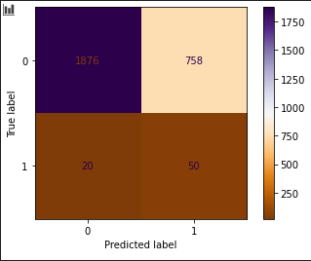
Random Forest Metrics
Module 5: Squeeze RF
Module 6: EMAs cross RF
Acc. Score: 0.71
Acc. Score: 70%
Estimators = 1000
Max_depth =25
Relevant Features 60%: bbup, bblo, kcup, kclo and 20sma.

Slide 14
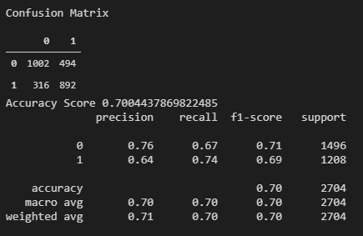
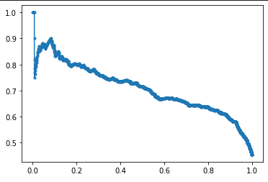
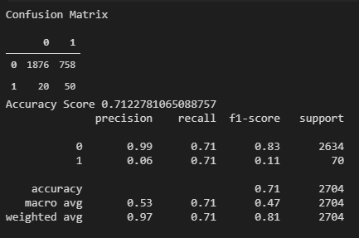
Random Forest Metrics
Module 5: Squeeze RF
Module 6: EMAs cross RF
Precision
Precision Recall Curve
Recall

Slide 15
algo-owls

Slide 16
algo-owls

Slide 17
Random Forest – Importance Features
%

